Slide 1
Bioassays

Slide 2
Normality Tests
Notes:
https://www.datanovia.com/en/lessons/normality-test-in-r/
https://stats.stackexchange.com/questions/191202/do-i-have-to-test-normality-for-both-groups-when-comparing-from-a-single-populat

Slide 3
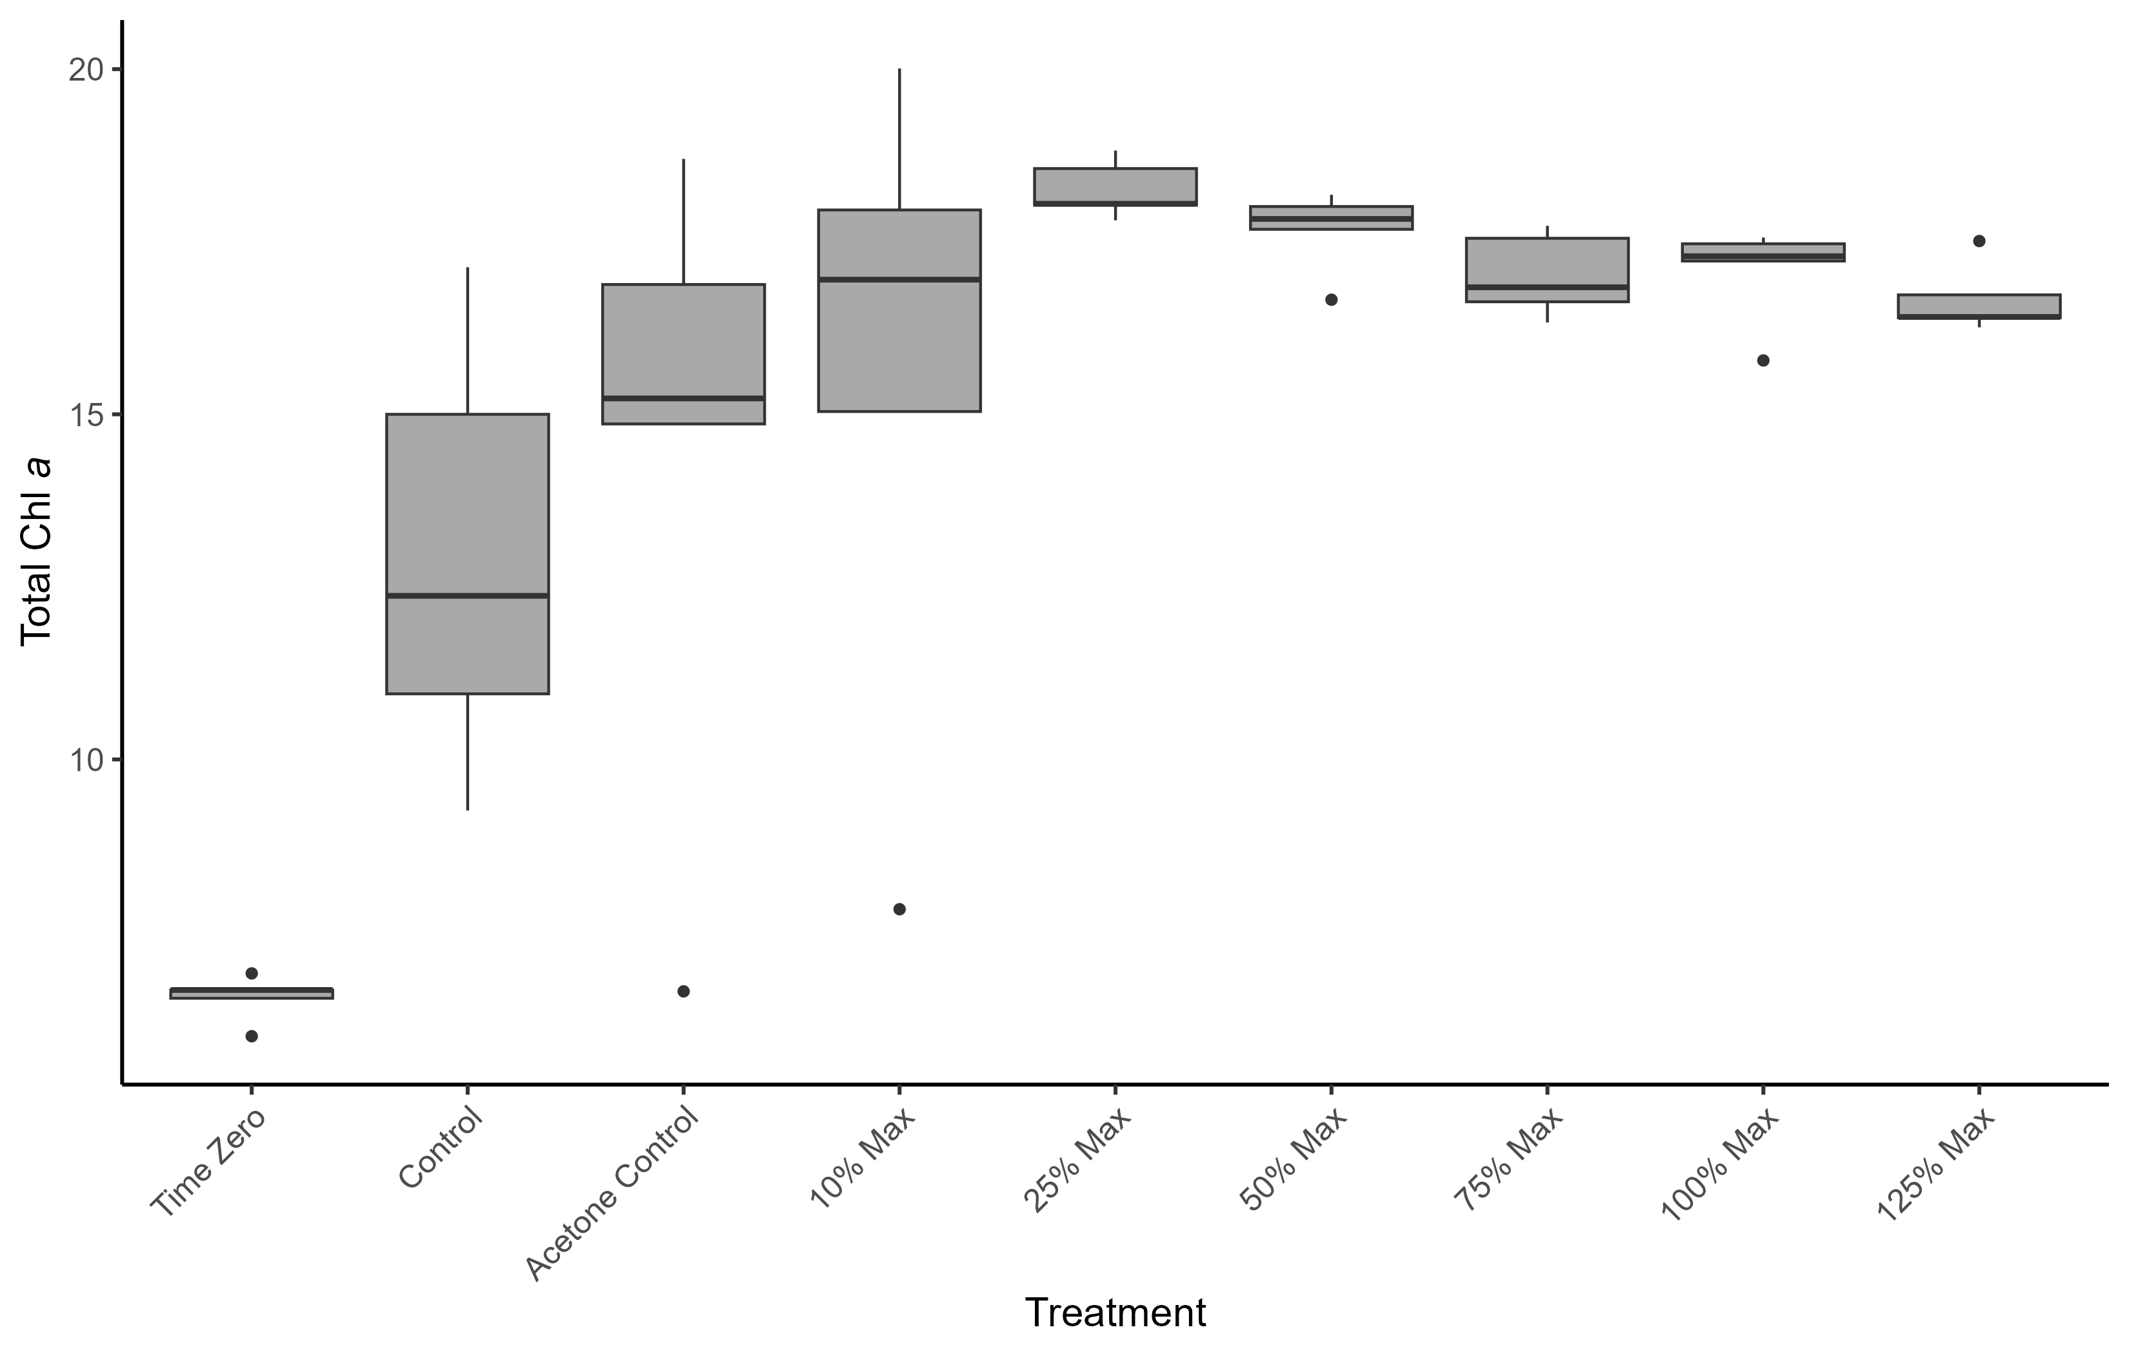
Carbamazepine - Biomass
ANOVA: p = 0.000102
Acetone Control > Time Zero
50% Max > Control
25% Max > Control
Control > Time Zero
50% Max > T0
100% Max > T0
125% Max > T0
75% Max > T0
10% Max > T0
25% Max > T0

Slide 4
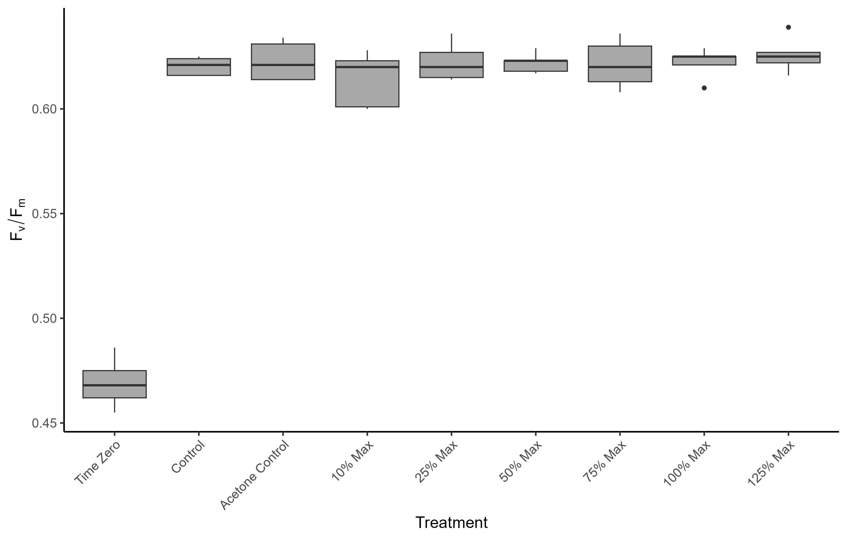
Carbamazepine - PAM
ANOVA: p = <2e-16
10% max > Time Zero
100% max > Time Zero
125% max > Time Zero
25% max > Time Zero
50% max > Time Zero
75% max > Time Zero
Acetone Control > Time Zero
Control > Time Zero

Slide 5
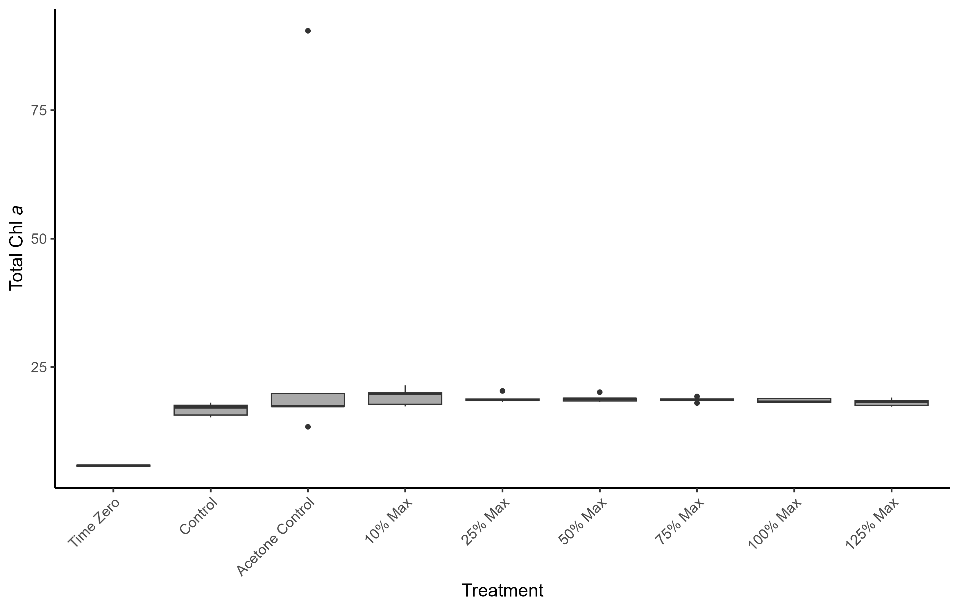
Diclofenac - Biomass
ANOVA: p = 0.121
Acetone Control > Time Zero

Slide 6
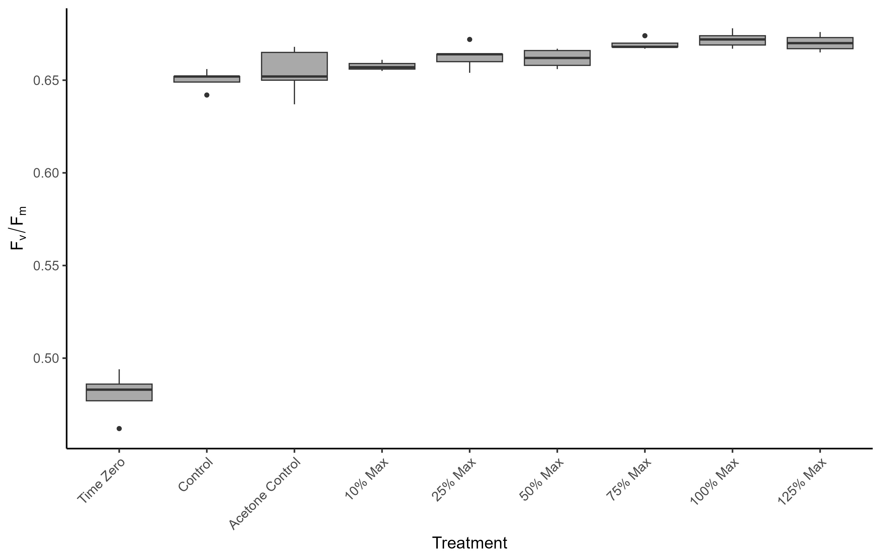
Diclofenac - PAM
ANOVA: p = <2e-16
10% max > Time Zero
100% max > Time Zero
125% max > Time Zero
25% max > Time Zero
50% max > Time Zero
75% max > Time Zero
Acetone Control > Time Zero
Control > Time Zero
100% max > 10% max, acetone control, control
125% max > control, acetone control
75% max > control, acetone control

Slide 7
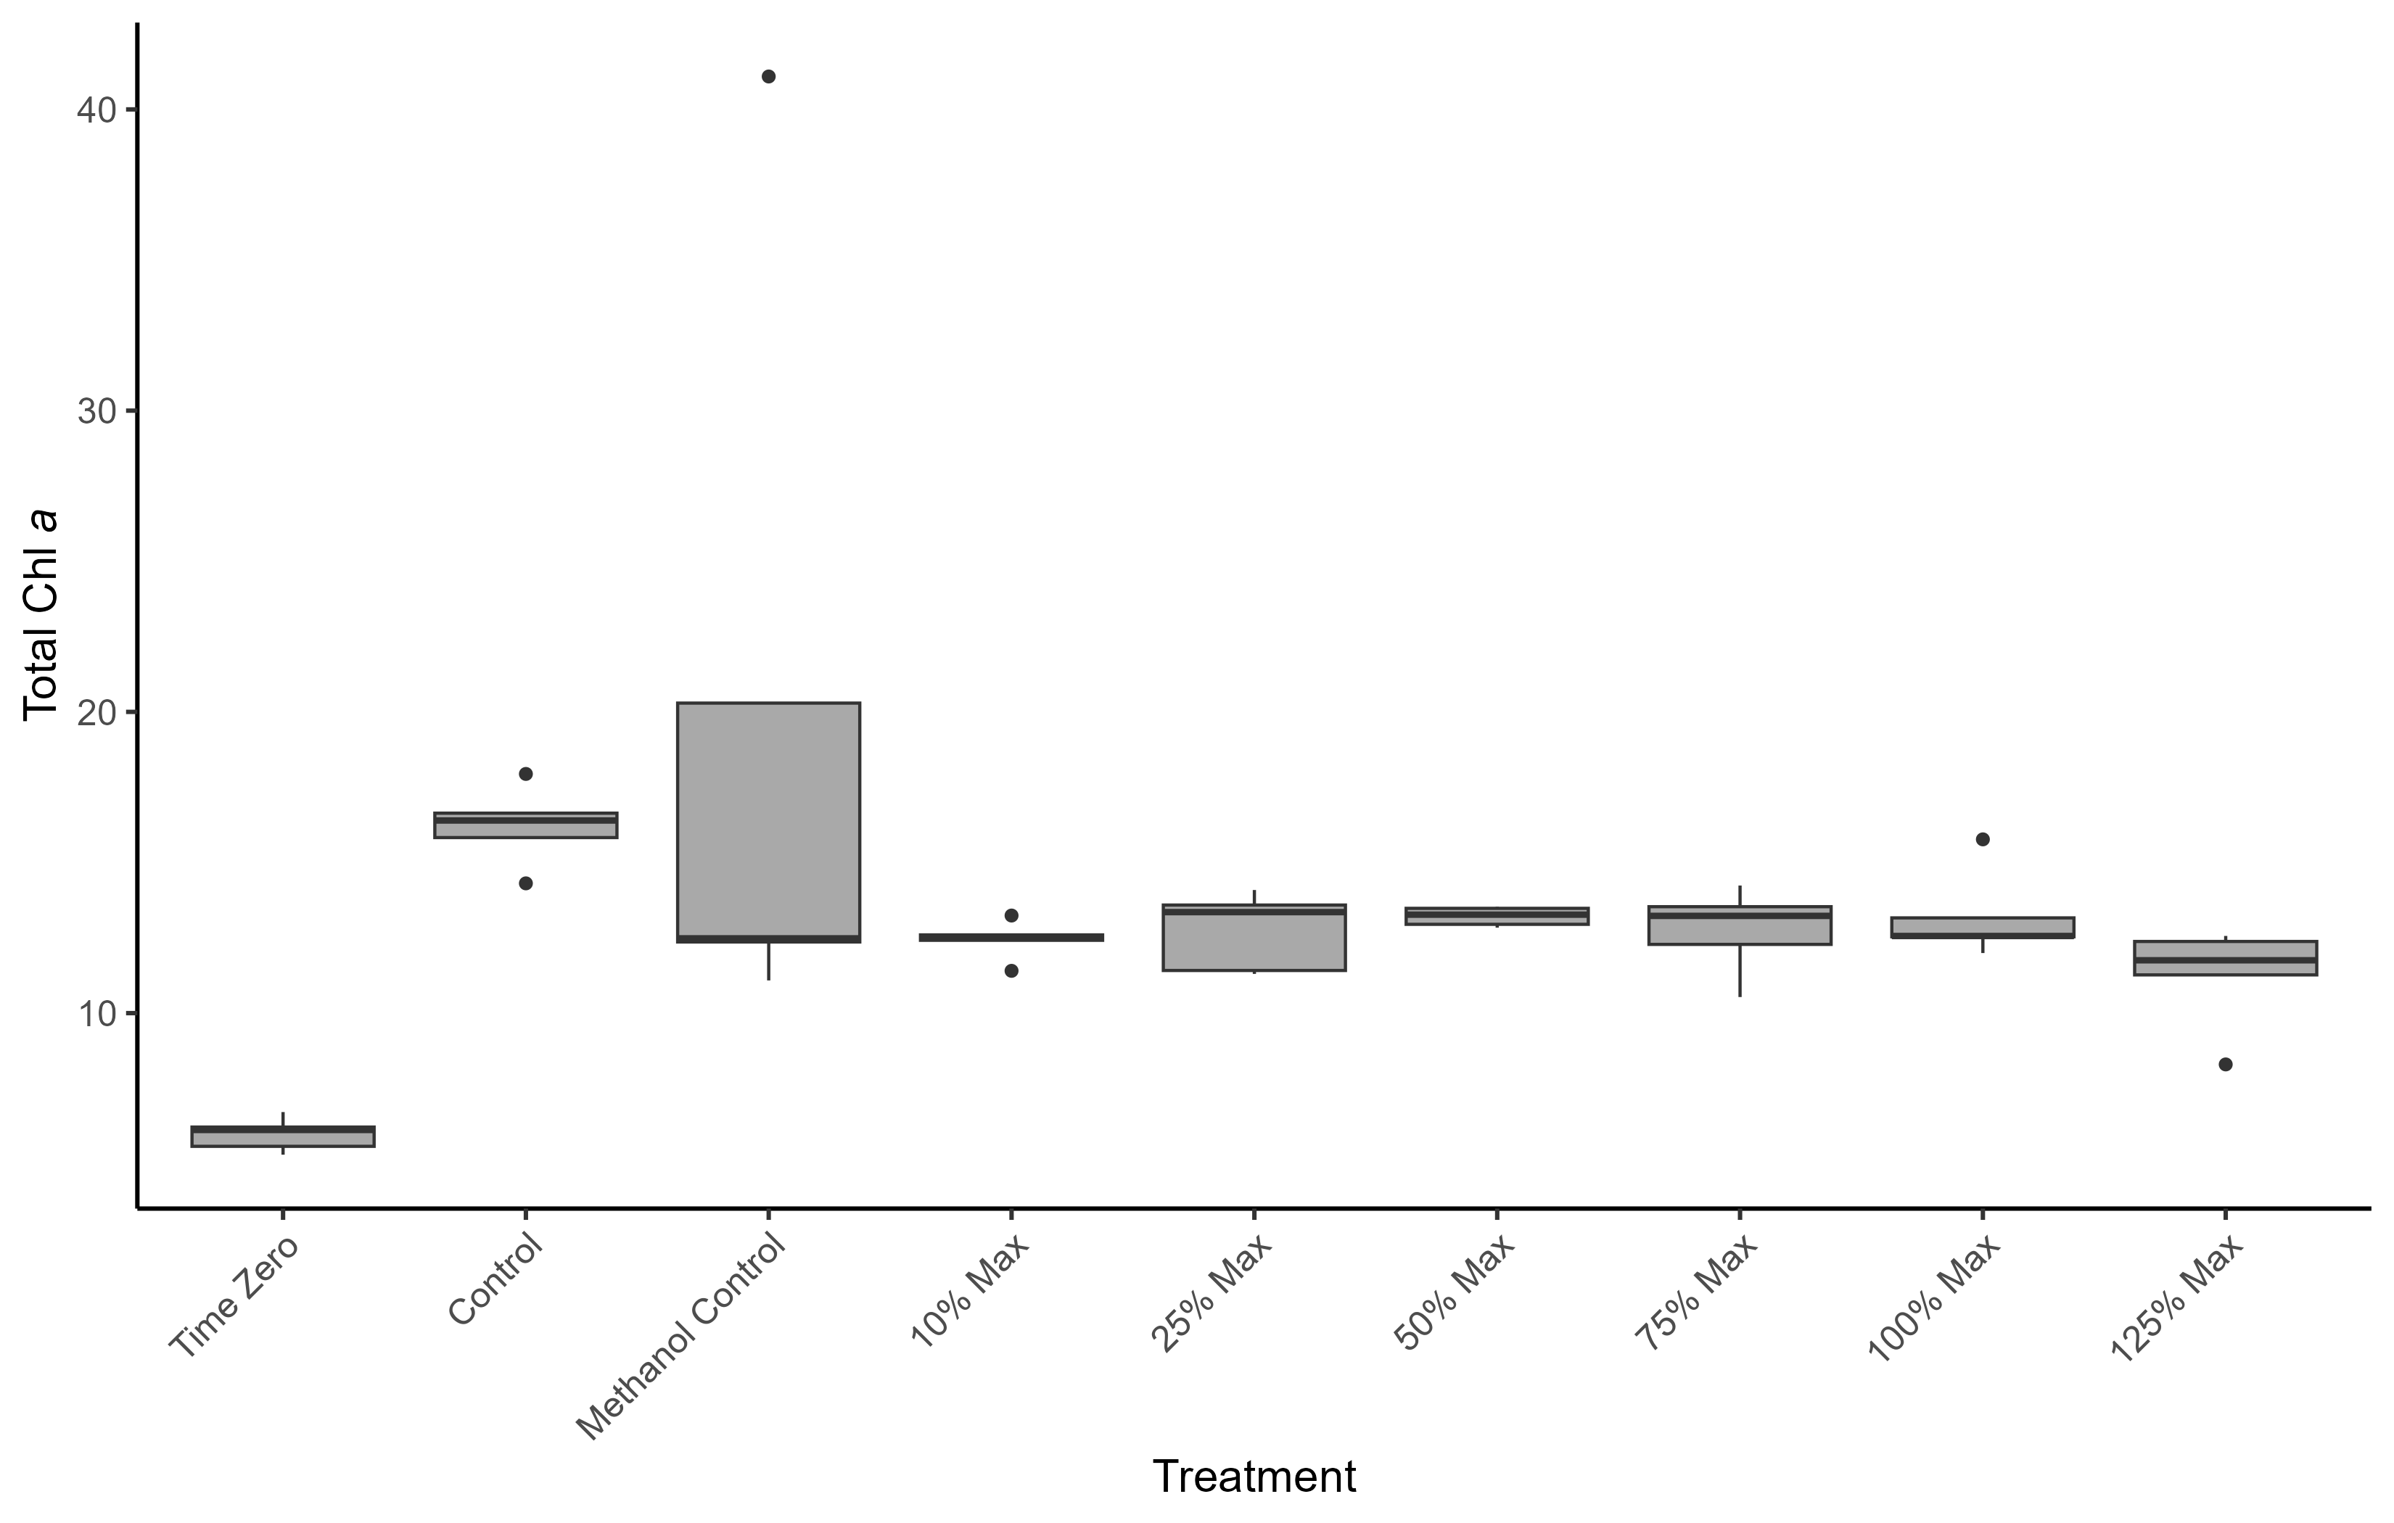
PFOS - Biomass
ANOVA: p = 0.00477
Methanol Control > Time Zero
Control > Time Zero

Slide 8
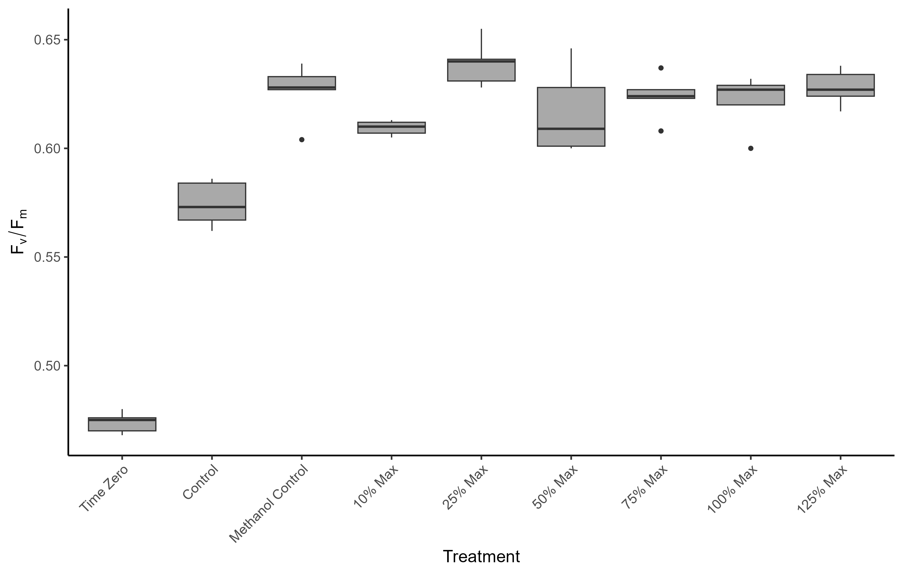
PFOS - PAM
ANOVA: p = <2e-16
Methanol Control, 10% max, 25% Max, 50% Max, 75% Max, 100% Max, 125% Max > Control
Control, Methanol Control, 10% max, 25% Max, 50% Max, 75% Max, 100% Max, 125% Max > Time Zero
25% Max > 10% Max

Slide 9
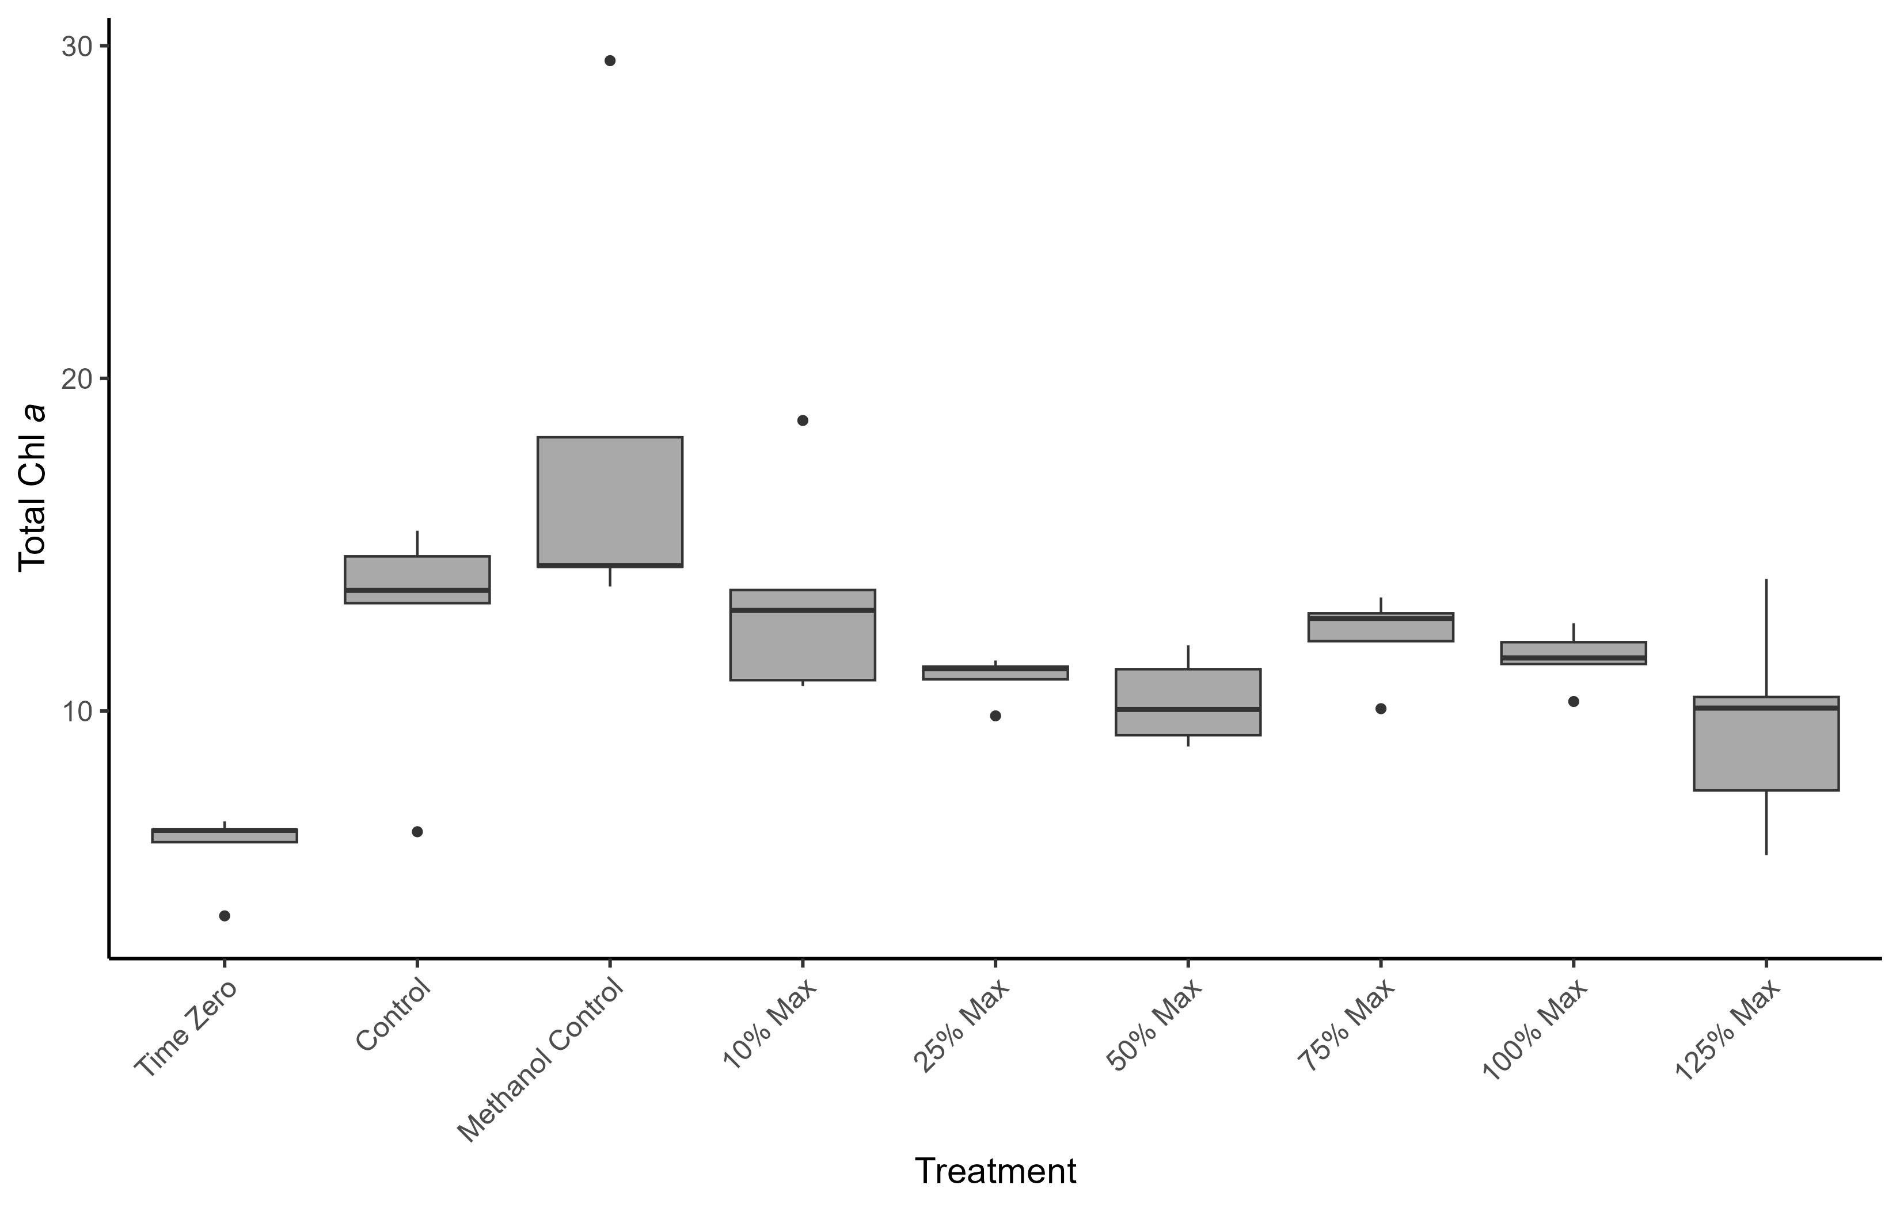
6ppd Quinone - Biomass
ANOVA: p = 0.000102
10% Max > T0
100% Max < Methanol Control
125% Max < Methanol
25% Max < Methanol
50% Max < Methanol
75% Max < Methanol
75% Max > T0
Methanol Control > Control
Methanol Control > Time Zero
Control > Time Zero

Slide 10
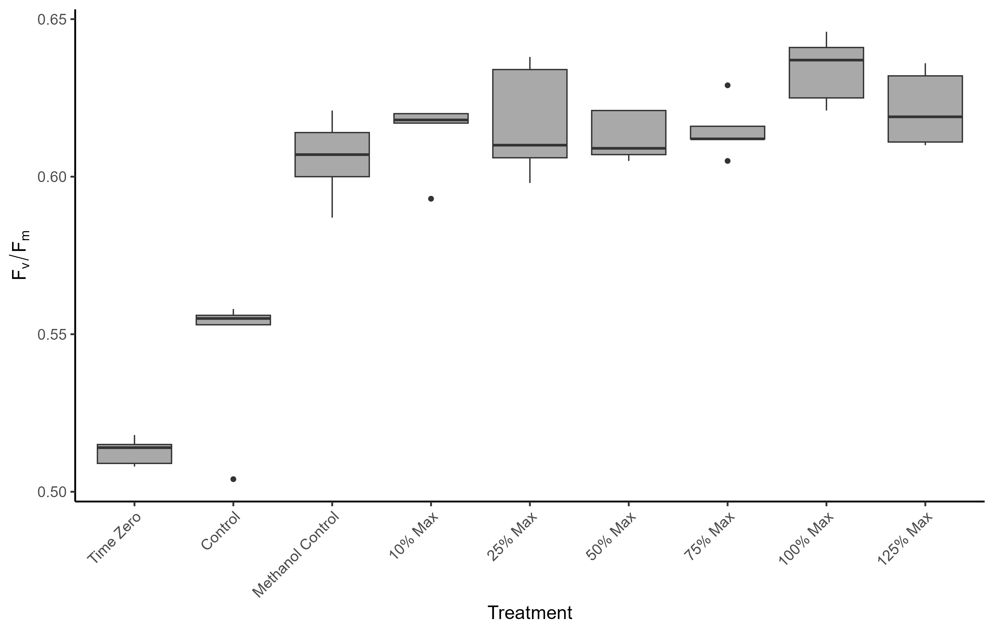
6ppd Quinone - PAM
ANOVA: p = <2e-16
Methanol Control, 10% max, 25% Max, 50% Max, 75% Max, 100% Max, 125% Max > Control
100% Max > Methanol Control
Control, Methanol Control, 10% max, 25% Max, 50% Max, 75% Max, 100% Max, 125% Max > Time Zero

